Slide 1


Ari Budi Prasetyo
15-07-2022

Slide 2

Outline
Executive Summary
Introduction
Methodology
Results
Conclusion
Appendix

Slide 3
Executive Summary
The following methodologies were used to analyze data:
Data Collection using web scraping and SpaceX Api
Exploratory Data Analysis (EDA), including data wrangling, data visualization and interactive data visualization
Machine learning prediction
Summary of all results
It was possible to collected valuable data from public source
EDA allowed to identify which features are the best to predict success of launchings
Machine learning prediction showed the best model to predict which characteristics are important to drive this opportunity

Slide 4
Introduction
The objective is to evaluate the viability of the new company space Y to compete whit space X
Desirable answers
The best way to estimate the total cost for launches, by predicting successful landings of the first stage of rockets
Where is the best place to make launches

Slide 5

Section 1

Slide 6
Methodology
Executive Summary
Data collection methodology:
Data from space X was obtained from 2 sources:
Space X API (https://api.spacexdata.com/v4)
Web scraping (https://en.wikipedia.org/wiki/List_of_Falcon\_9\_and_Falcon_Heavy_launches)
Perform data wrangling
Collected data was enriched by creating a landing outcome label based on outcome data after summarizing and analyzing features
Perform exploratory data analysis (EDA) using visualization and SQL

Slide 7
Methodology
Executive Summary
Perform interactive visual analytics using Folium and Plotly Dash
Perform predictive analysis using classification models
Data that was collected until this step were normalized, divided in training and test data sets and evaluated by four different classification models, being the accuracy of each model evaluated using different combinations of parameters.

Slide 8
Data Collection
Data sets were collected from Space X API ( https://api.spacexdata.com/v4 ) and from Wikipedia (https://en.wikipedia.org/wiki/List_of_Falcon/_9/_and_Falcon_Heavy_launches ), using web scraping technics.

Slide 9
Data Collection – SpaceX API
Space X offers a public API from where data can be obtained and then used
This API was used according to the flowchart beside and then data is persisted
Source code : https://github.com/arityo182/IBM-Data-Science-Capstone/blob/main/Data%20Collection%20API.ipynb
Request Api And parse the space x launch data
Filter the dataframe to only include Falcon 9 launches
Dealing with Missing Values

Slide 10
Data Collection - Scraping
Data from space X launches can also be obtained from Wikipedia
Data are downloaded from Wikipedia according to the flowchart and then persisted
Source code : https://github.com/arityo182/IBM-Data-Science-Capstone/blob/main/Data%20Collection%20with%20Web%20Scraping.ipynb
Request the Falcon9 Launch Wiki page from its URL
Extract all column/variable names from the HTML table header
Create a data frame by parsing the launch HTML tables

Slide 11
Data Wrangling
Initially some Exploratory Data Analysis (EDA) was performed on the dataset.
Then the summaries number of launches on each site, after that amount occurrence of each orbit.
Then the summaries launches per site, occurrences of each orbit and occurrences of mission outcome per orbit type were calculated.
The landing outcome label was created from Outcome column.
Finally, Create a class label from Outcome column
Source Code : https://github.com/arityo182/IBM-Data-Science-Capstone/blob/main/Data%20Wrangling%20EDA.ipynb
EDA
Calculate the number of launches on each site
Calculate the number and occurrence of each orbit
Calculate the number and occurence of mission outcome per orbit type
Create a landing outcome label from Outcome column

Slide 12
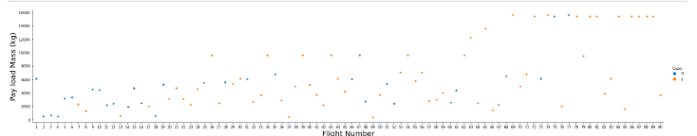
EDA with Data Visualization
To explore data, scatterplots and barplots were used to visualize the relationship between pair of features:
Flight Number and Launch Site, Payload and Launch Site, success rate of each orbit type, Flight Number and Orbit type, Payload and Orbit type
Source code : https://github.com/arityo182/IBM-Data-Science-Capstone/blob/main/EDA%20with%20Visualization.ipynb

Slide 13
EDA with SQL
The following SQL queries were performed:
Display the names of the unique launch sites in the space mission
Display 5 records where launch sites begin with the string 'CCA’
Display the total payload mass carried by boosters launched by NASA (CRS)
Display average payload mass carried by booster version F9 v1.1
List the date when the first successful landing outcome in ground pad was achieved
List the names of the boosters which have success in drone ship and have payload mass greater than 4000 but less than 6000
List the total number of successful and failure mission outcomes
List the names of the booster versions which have carried the maximum payload mass. Use a subquery
List the failed landing outcomes in drone ship, their booster versions, and launch site names for in year 2015
Rank the count of landing outcomes (such as Failure (drone ship) or Success (ground pad)) between the date 2010-06-04 and 2017-03-20, in descending order
Source Code : https://github.com/arityo182/IBM-Data-Science-Capstone/blob/main/EDA%20with%20SQL.ipynb

Slide 14
Build an Interactive Map with Folium
Markers, circles, lines and marker clusters were used with Folium Maps
Mark all launch sites on a map
Mark the success/failed launches for each site on the map
Calculate the distances between a launch site to its proximities
Source Code : https://github.com/arityo182/IBM-Data-Science-Capstone/blob/main/Interactive%20Visual%20Analytics%20with%20Folium%20lab.ipynb

Slide 15
Build a Dashboard with Plotly Dash
The following graphs and plots were used to visualize data
Percentage of launches by site
Payload range
This combination allowed to quickly analyze the relation between payloads and launch sites, helping to identify where is best place to launch according to payloads.
Source code : https://github.com/arityo182/IBM-Data-Science-Capstone/blob/main/spacex_dash_app.py

Slide 16
Predictive Analysis (Classification)
Four classification models were compared: logistic regression, support vector machine, decision tree and k nearest neighbors.
Source code : https://github.com/arityo182/IBM-Data-Science-Capstone/blob/main/Complete%20the%20Machine%20Learning%20Prediction%20lab%20END.ipynb
Data preparation and Standardize
Split data train and testing
Train and test data with combinations hyperparameters
Comparison of result

Slide 17
Results
Exploratory data analysis result
Space X uses 4 different launch sites;
The first launches were done to Space X itself and NASA;
The average payload of F9 v1.1 booster is 2,928 kg;
The first success landing outcome happened in 2015 fiver year after the first launch;
Many Falcon 9 booster versions were successful at landing in drone ships having payload above the average;
Almost 100% of mission outcomes were successful;
Two booster versions failed at landing in drone ships in 2015: F9 v1.1 B1012 and F9 v1.1 B1015;
The number of landing outcomes became as better as years passed.

Slide 18
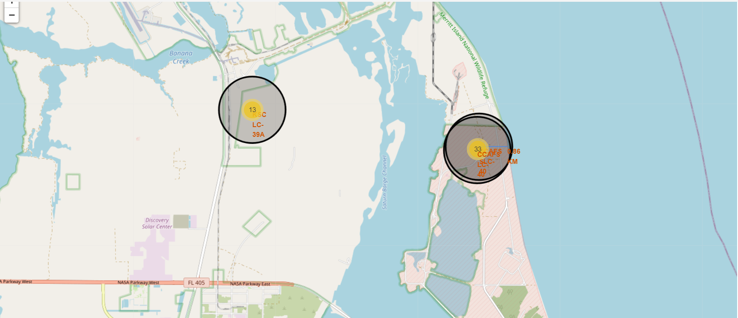
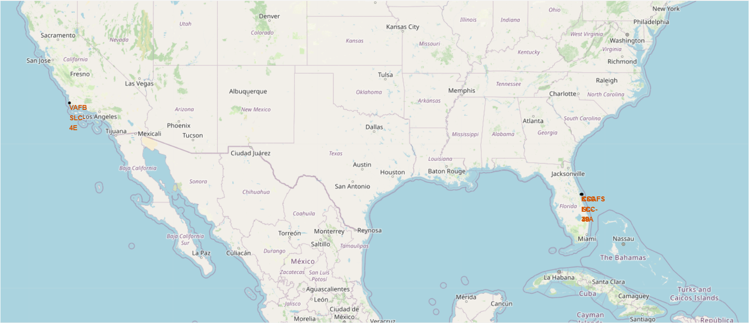
Results
Interactive analytics demo in screenshots
Using interactive analytics was possible to identify that launch sites use to be in safety places, near sea, for example and have a good logistic infrastructure around.
Most launches happens at east cost launch sites.

Slide 19
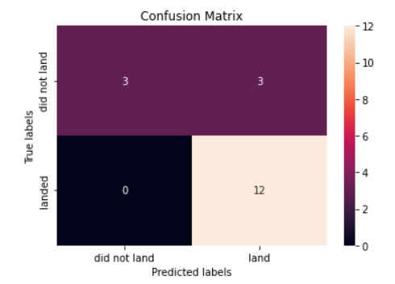
Results
Predictive analysis results
Predictive Analysis showed that Decision Tree Classifier is the best model to predict successful landings, having accuracy over 0.90 and accuracy for test data over 0.83

Slide 20

Section 2

Slide 21
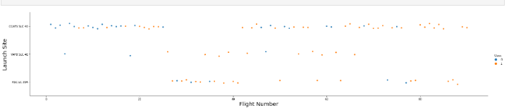
Flight Number vs. Launch Site
According to the plot above, it’s possible to verify that the best launch site nowadays is CCAF5 SLC 40, where most of recent launches were successful
In second place VAFB SLC 4E and third place KSC LC 39A
It’s also possible to see that the general success rate improved over time.

Slide 22
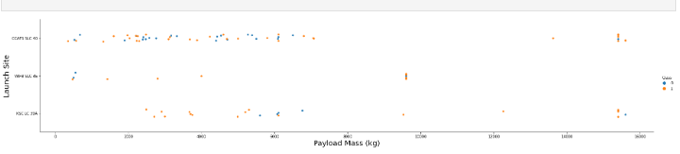
Payload vs. Launch Site
Payloads over 9,000kg (about the weight of a school bus) have excellent success rate
Payloads over 12,000kg seems to be possible only on CCAFS SLC 40 and KSC LC 39A launch sites.

Slide 23
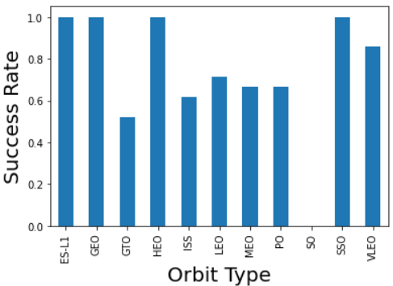
Success Rate vs. Orbit Type
The biggest success rates happens to orbits:
ES L1
GEO
HEO
SSO.
Followed by:
VLEO (above 80%)
LFO (above 70%).

Slide 24
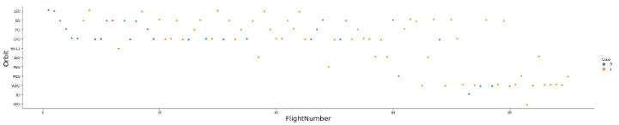
Flight Number vs. Orbit Type
Apparently, success rate improved over time to all orbits
VLEO orbit seems a new business opportunity, due to recent increase of its frequency.

Slide 25
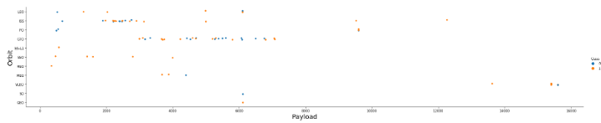
Payload vs. Orbit Type
Apparently, there is no relation between payload and success rate to orbit GTO
ISS orbit has the widest range of payload and a good rate of success
There are few launches to the orbits SO and GEO.

Slide 26
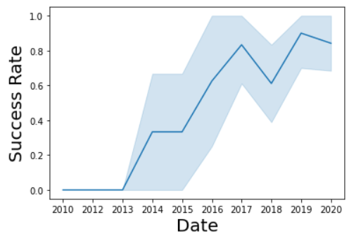
Launch Success Yearly Trend
Success rate started increasing in 2013 and kept until 2020
It seems that the first three years were a period of adjusts and improvement of technology.

Slide 27
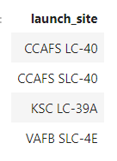
All Launch Site Names
According to data, there are four launch sites:
They are obtained by selecting unique occurrences of “launch_site” values from the dataset.

Slide 28
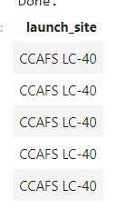
Launch Site Names Begin with 'CCA'
5 records where launch sites begin with `CCA`:
Here we can see five samples of Cape Canaveral launches.

Slide 29
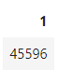
Total Payload Mass
Total payload carried by boosters from NASA:
Total payload calculated above, by summing all payloads whose codes contain ‘ CRS’, which corresponds to NASA.

Slide 30
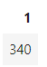
Average Payload Mass by F9 v1.1
Average payload mass carried by booster version F9 v1.1:
Filtering data by the booster version above and calculating the average payload mass we obtained the value of 340 kg.

Slide 31
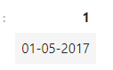
First Successful Ground Landing Date
First successful landing outcome on ground pad:
By filtering data by successful landing outcome on ground pad and getting the minimum value for date it’s possible to identify the first occurrence, that happened on 01/05/2017.

Slide 32
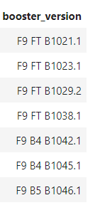
Successful Drone Ship Landing with Payload between 4000 and 6000
Boosters which have successfully landed on drone ship and had payload mass greater than 4000 but less than 6000
Selecting distinct booster versions according to the filters above, these 7 are the result.

Slide 33
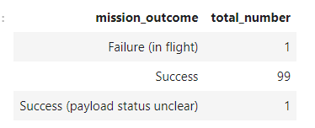
Total Number of Successful and Failure Mission Outcomes
Number of successful and failure mission outcomes:
Grouping mission outcomes and counting records for each group led us to the summary above.

Slide 34
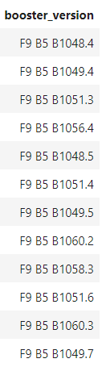
Boosters Carried Maximum Payload
Boosters which have carried the
maximum payload mass
These are the boosters which have carried the
maximum payload mass registered in the dataset.

Slide 35
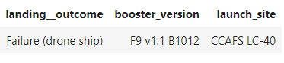
2015 Launch Records
Failed landing outcomes in drone ship, their booster versions, and launch site names for in year 2015
The list above has the only one occurrences.

Slide 36
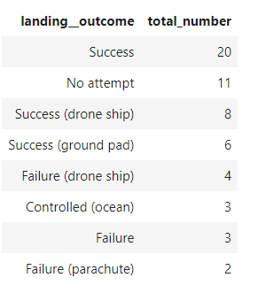
Rank Landing Outcomes Between 2010-06-04 and 2017-03-20
Ranking of all landing outcomes between the date 2010-06-04 and 2017-03-20:
This view of data alerts us that “Success” must be taken in account.

Slide 37

Section 3

Slide 38
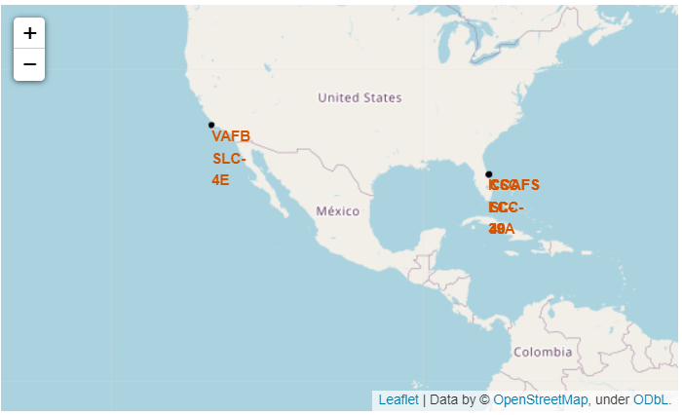
All Launch Sites
Launch sites are near sea, probably by safety, but not too far from roads and railroads.

Slide 39
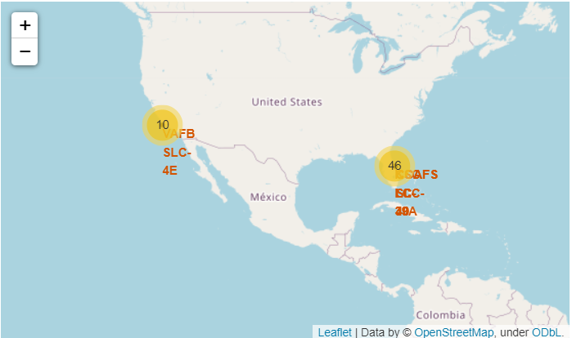
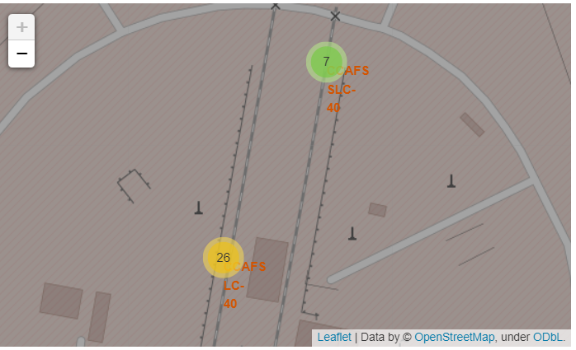
Success/Failed Launches For Each Site on the Map
Example of CCAFS SLC-40 launch site launch outcomes
Green markers indicate successful and red ones indicate failure.

Slide 40
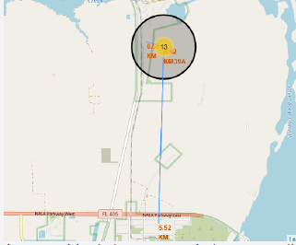
<Folium Map Screenshot 3>
Launch site KSC LC 39A has good logistics aspects, being near railroad and road and relatively far from inhabited areas.

Slide 41

Section 4

Slide 42
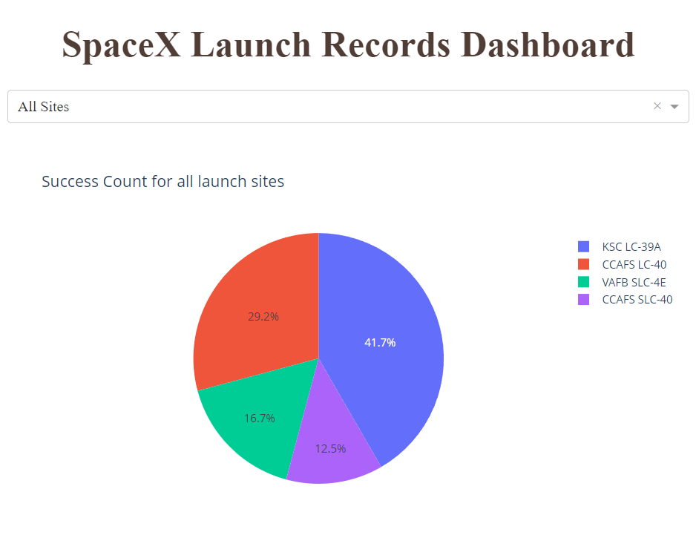
Successful Launches by Site
The place from where launches are done seems to be a very important factor of success of missions.

Slide 43
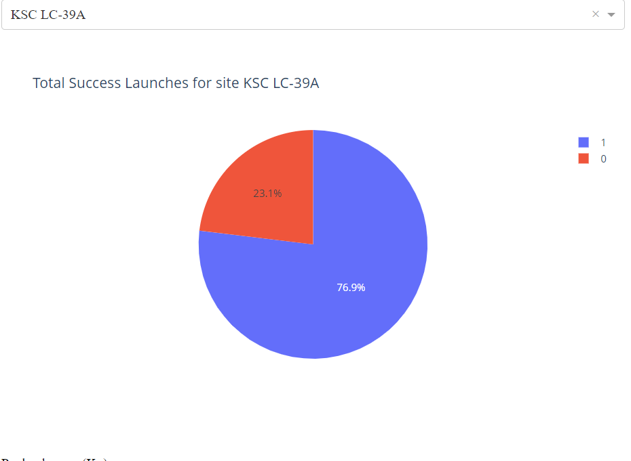
Launch Success Ratio for KSC LC-39A
76.9% of launches are successful in this site.

Slide 44
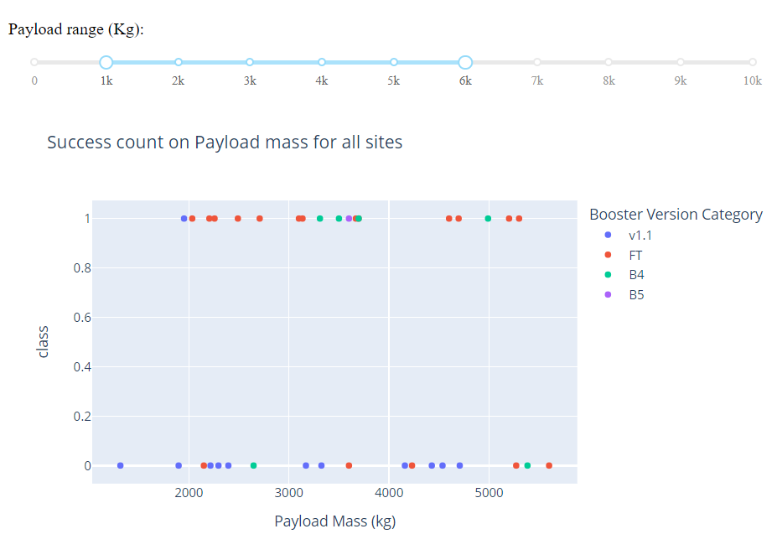
Payload vs. Launch Outcome
Payloads under 6,000kg and FT boosters are the most successful combination.

Slide 45
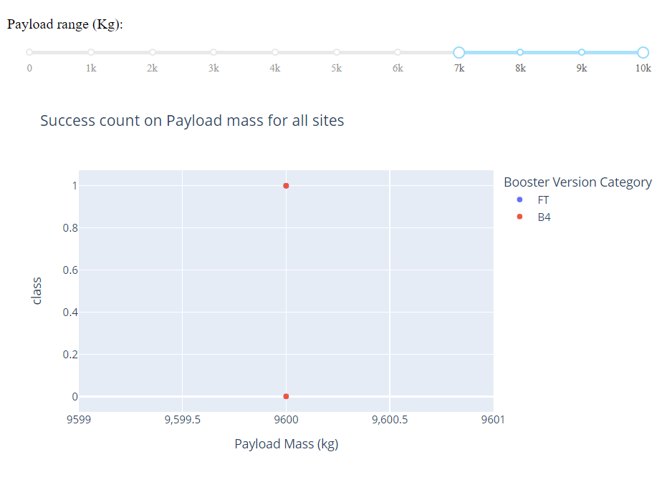
Payload vs. Launch Outcome
There’s not enough data to estimate risk of launches over 7,000kg

Slide 46

Section 5

Slide 47
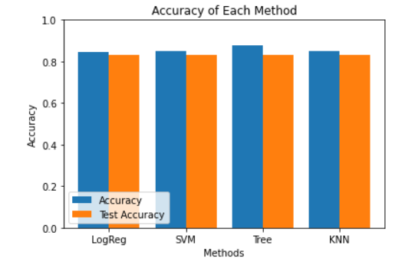
Classification Accuracy
Four classification models were tested, and their accuracies are plotted beside
The model with the highest classification accuracy is Decision Tree Classifier, which has accuracies over than 87%.

Slide 48
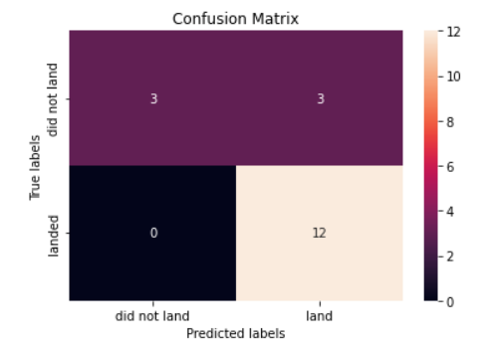
Confusion Matrix
Confusion matrix of Decision Tree Classifier proves its accuracy by showing the big numbers of true positive and true negative compared to the false ones.

Slide 49
Conclusions
Different data sources were analyzed, refining conclusions along the process
The best launch site is KSC LC 39A
Launches above 7,000kg are less risky
Although most of mission outcomes are successful, successful landing outcomes seem to improve over time, according the evolution of processes and rockets;
Decision Tree Classifier can be used to predict successful landings and
increase profits.

Slide 50
Appendix
As an improvement for model tests, it’s important to set a value to np.random.seed variable
Folium didn’t show maps on Github.

Slide 51


